Slide 1
FoxMeyer Case: The Failure of ERP Implementation
Final Presentation – Introduction to Project Management
Ajay Muthukrishnan
Arkojyoti Hore
Eric Sargent
Parth Shiras
Shriket Pai
Swetha Sree
Vamsi Batchu
Vinit Gupta
12/02/2016

Slide 2
Agenda
Analyses & Planning
01
Who are Fox Meyer ?
02
Enterprise Resource Planning
03
Viewpoints: Internal & External
04
Conclusion
05

Slide 3
Analyses & Planning
Project Charter
Work Breakdown Structure
RACI matrix
Budget Report
Risk Logs
Project Status Template

Slide 4
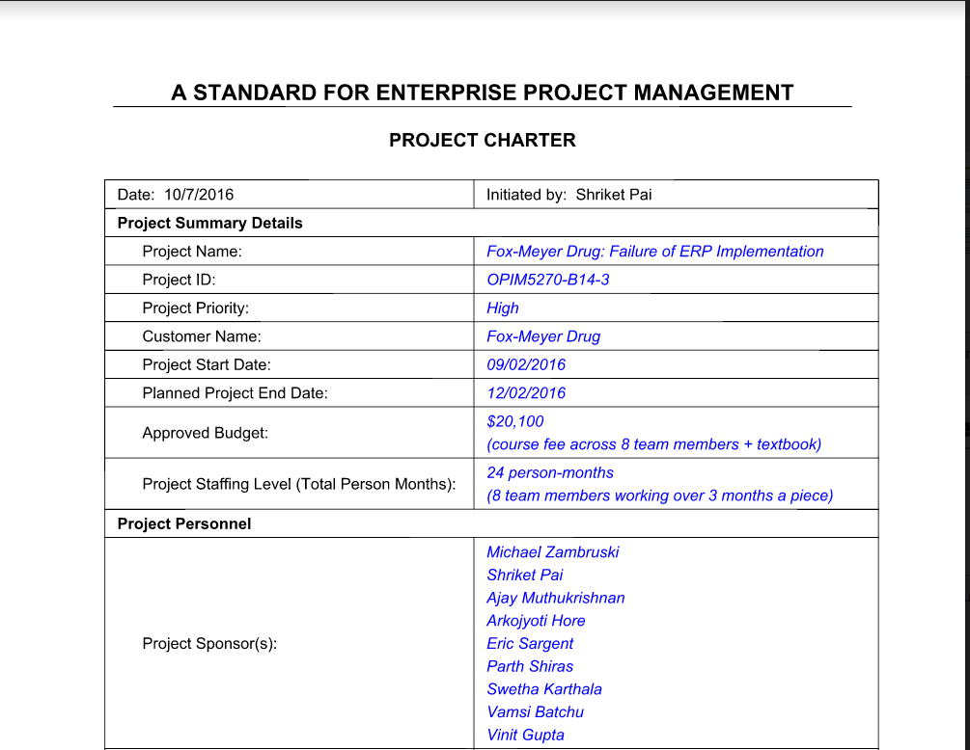
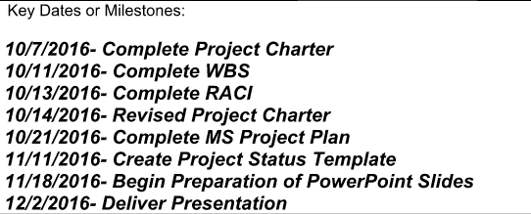
Project Charter
Project charter, the outcome of the project initiation phase, formally authorizes the work of the project to begin (or continue) and gives the project manager authority to do his job.

Slide 5
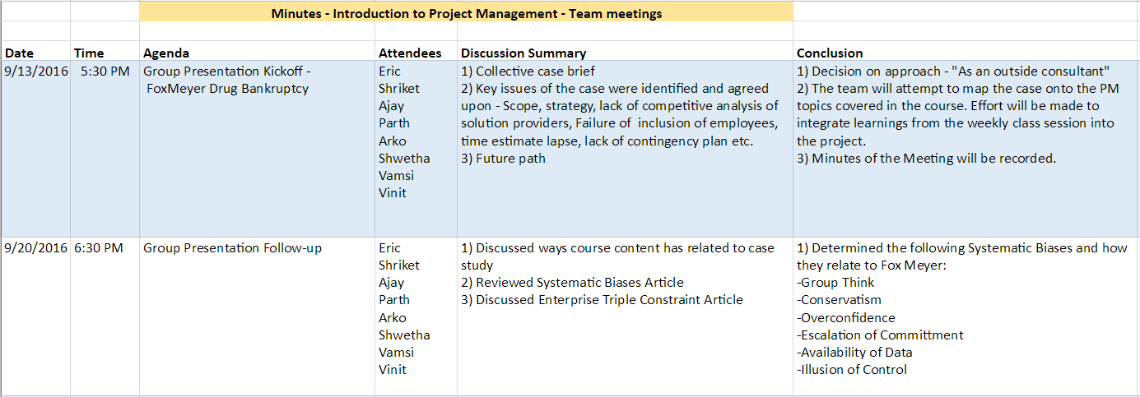
Project Meeting Minutes

Slide 6
WBS/Gantt Chart
WBS is a hierarchical and incremental decomposition of the project into phases, deliverables and work packages
It is a tree structure, which shows a subdivision of effort required to achieve an objective

Slide 7
RACI Matrix
RACI is an acronym that stands for responsible, accountable, consulted and informed
A RACI chart is a matrix of all the activities or decision making authorities undertaken in an organization set against all the people or roles

Slide 8
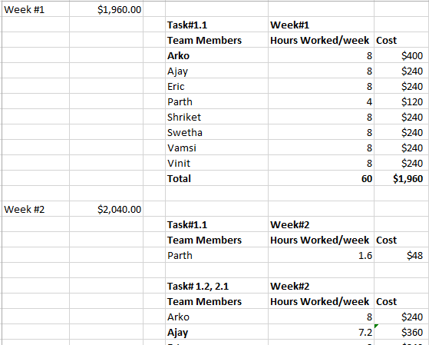
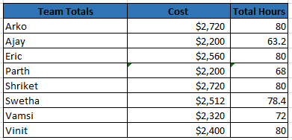
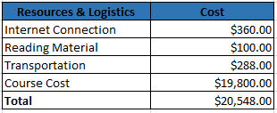
Budget Report
Budget Report includes the forecast of the resources required for the project.
Manager cost : $50/hour
Team member cost : $30/hour

Slide 9
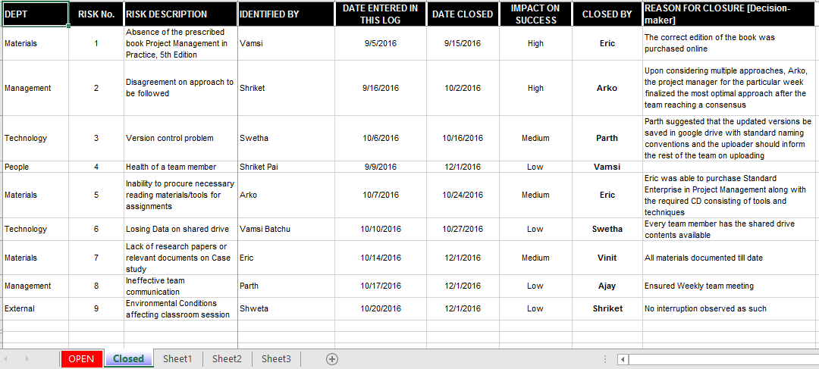
Risk/Issue Log
Risk log is used to ensure that no conceivable risk is missed out on mitigating effort.

Slide 10
Who are FoxMeyer?
Facts
5th largest distributor
500,000 daily shipments
Services
$
$5 billion sales
Conduct Business in franchising variety stores
Distribute full line of Pharmaceutical products
Provide Managed care and information based services

Slide 11
ERP Implementation
Business Process Management Software
What?
?
Multiple enterprise software modules
Central repository for all information
Intense market competition
Why?
?
Meet the increased cost pressure
Help make complex supply chain decisions
Provide real-time information
How?
?
Automate and integrate inventory systems

Slide 12
Project Performance Criteria
Delivery of First Phase was scheduled for early 1995 which was later advanced by 3 months
Schedule
Initial plan scope was to implement R/3 software at 6 new warehouses which was later amended to include 17 old warehouses as well
Scope
Estimated cost is $65 million
Cost
Seamlessly handle all the invoices of the warehouse which is about 420000 transactions per day
Quality
Sure-shot success with negligible probability of any risk
Risk
Notes:
Vamsi

Slide 13


Factors Responsible
The Failure of FoxMeyer Project can be viewed from two perspectives:
Planning
Implementation
Notes:
Vinit

Slide 14


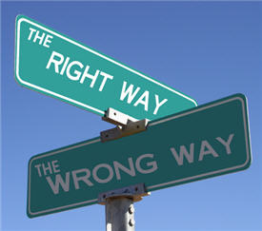
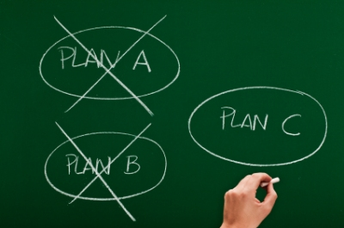
Factors Responsible – Planning
Failure to Perform thorough Business Analysis
Poor Selection of Software – SAP R/3
No consideration of other consultant’s advice
Lack of contingency planning
Notes:
Vinit – E
Swetha – E
Ajay – E
Swetha - E

Slide 15


Factors Responsible – Planning
Communication gap
No end user involvement
Notes:
Shriket – I

Slide 16



Factors Responsible – Implementation
No restructuring of the business process was done
Poor Management support
Over-ambitious project scope
Notes:
Vinit - E
Swetha - E
Ajay - E

Slide 17


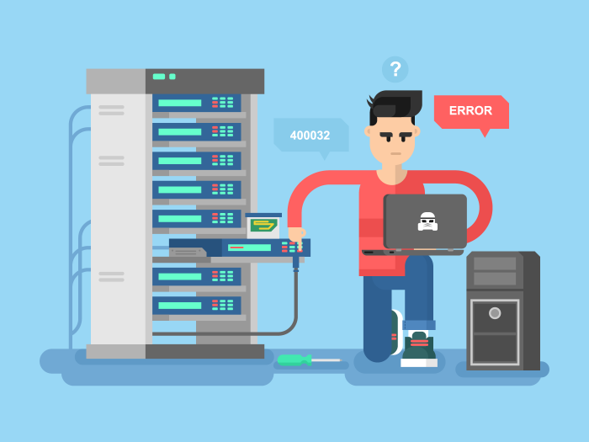
Factors Responsible – Implementation
Insufficient testing
Lack of end-user cooperation
Dominance of IT specialists’ personal interest
Notes:
Shriket – I
Vamsi - I

Slide 18



Key Points
Planning & Implementation Failures
Presence of Systematic Biases
Disregard for Enterprise Triple Constraints

Slide 19

Project Failure – Systematic Biases
Groupthink
Conservatism
Illusion of control
Overconfidence
Sunk Cost
Notes:
Vinit – Conservatism
Ajay – Groupthink
Vamsi – Illusion of control
Shriket – Overconfidence
Swetha – Sunk Cost

Slide 20
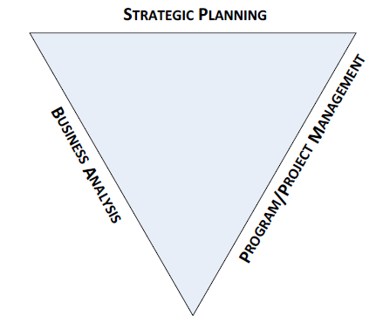
Enterprise Triple Constraints
No restructuring of the business process
Over-ambitious project scope
Enterprise Triple Constraints
Poor selection of software
No consideration of other consultants’ advice
Failure to understand how a proposed solution will improve the existing situation
Lack of stakeholder Involvement
Lack of Contingency Planning
Poor Management Support
Illusion of Control
No end user involvement
Insufficient testing
Notes:
Shriket – Business Analysis
Swetha – Strategic planning
Ajay - Project Management

Slide 21

Questions?

